Slide 1

OJP & OSDM
Andreas Schlapbach (andreas.schlapbach@sbb.ch)
25.02.2021

Slide 2
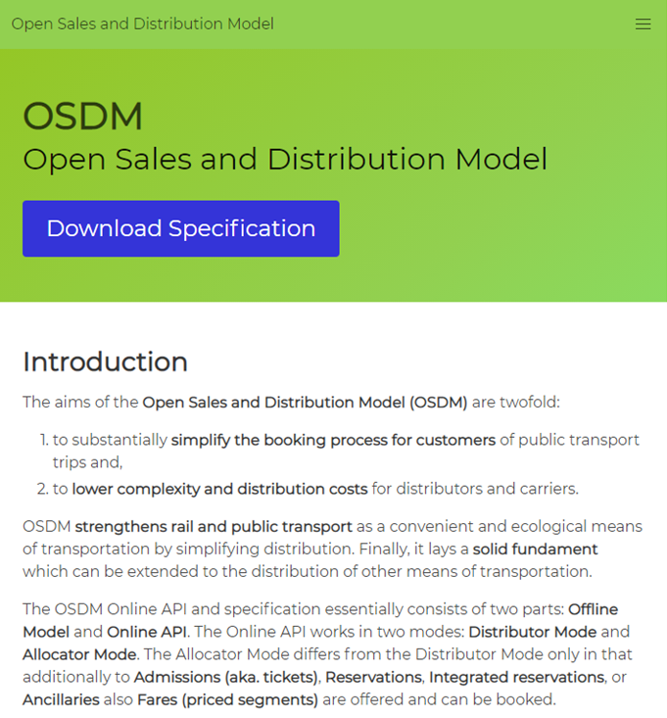
OSDM – What is it?
The aims of the Open Sales and Distribution Model (OSDM) are twofold:
to substantially simplify the booking process for customers of public transport trips and,
to lower complexity and distribution costs for distributors and carriers.
OSDM strengthens rail and public transport as a convenient and ecological means of transportation by simplifying distribution. Finally, it lays a solid fundament which can be extended to the distribution of other means of transportation.
https://unioninternationalcheminsdefer.github.io/OSDM/

Slide 3
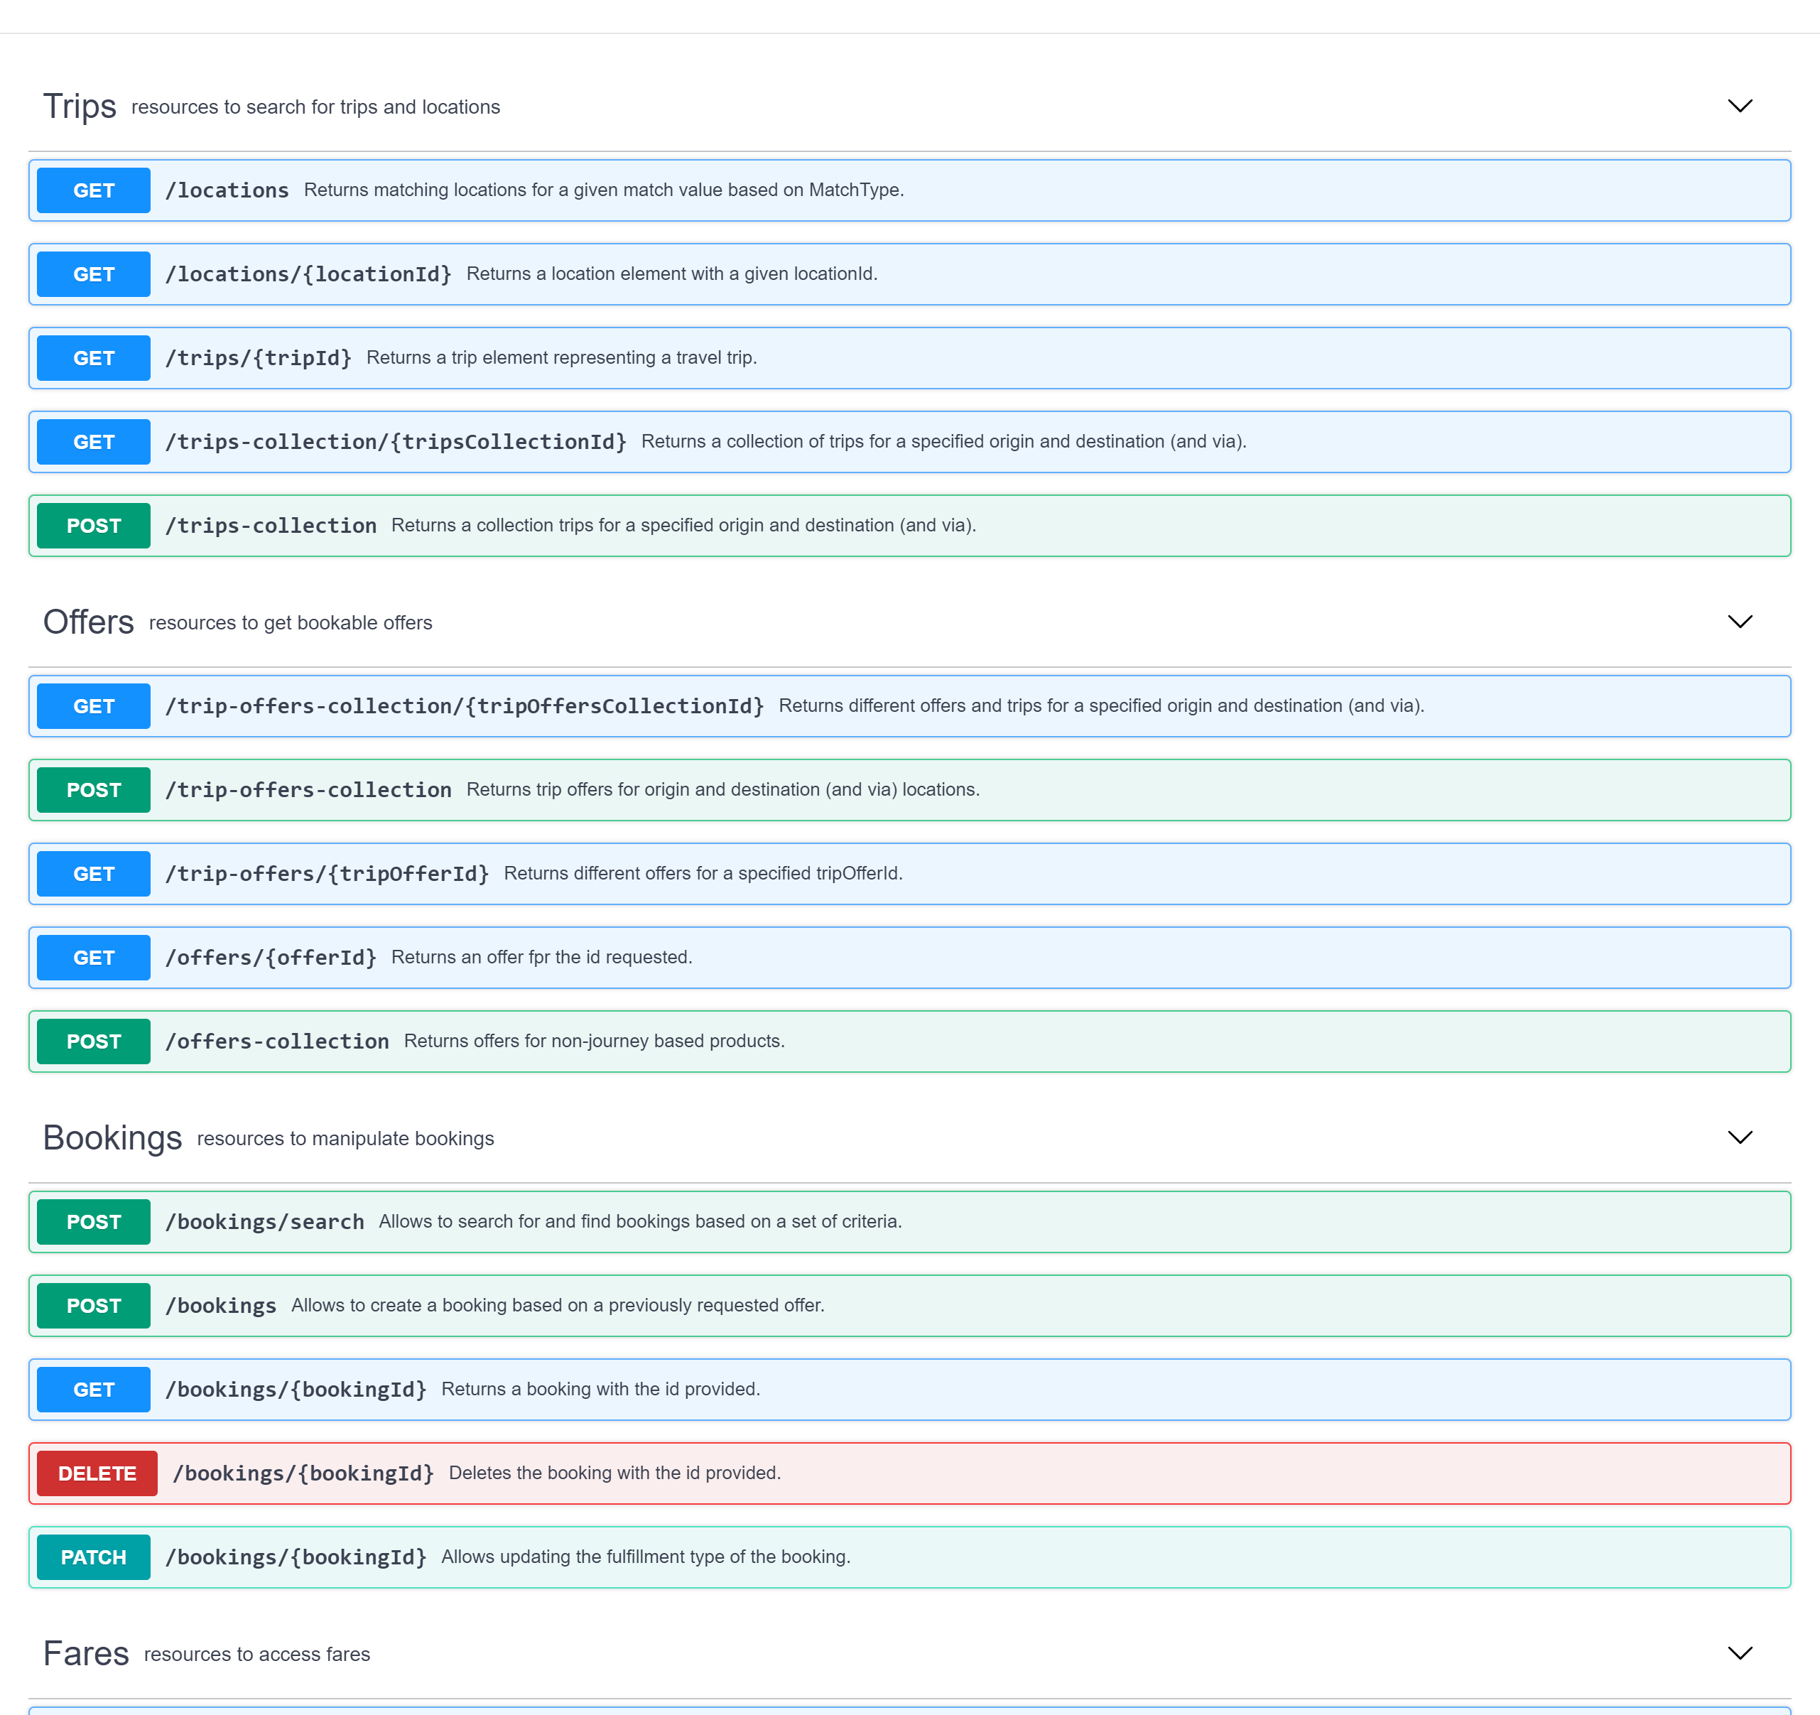
OSDM Flows
A booking process is modelled by the following steps:
Searching for trips
Getting offers
Booking an offer
Confirmation of the booking
Fulfillment of the booking
Analogously, the after-sale process is modelled in the following steps:
Getting a refund/exchange offers
Booking a refund/exchange offer
Fulfillment of the booking

Slide 4
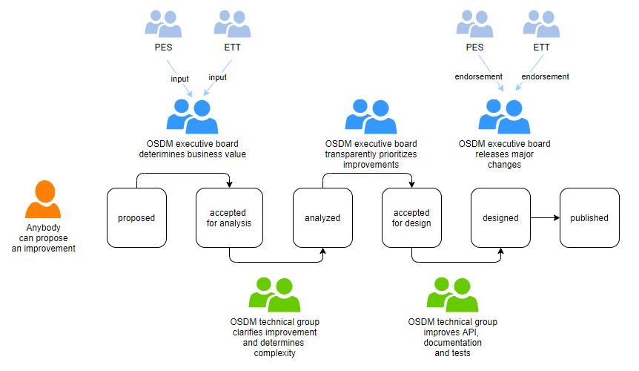
OSDM is Open Source, Contributions are Welcome
Development happens on GitHub and on GitHub Wiki. We have a backlog of improvements and work in an agile manner.
Everybody can contribute to the backlog.
We meet every Friday 9:00-11:00.

Slide 5
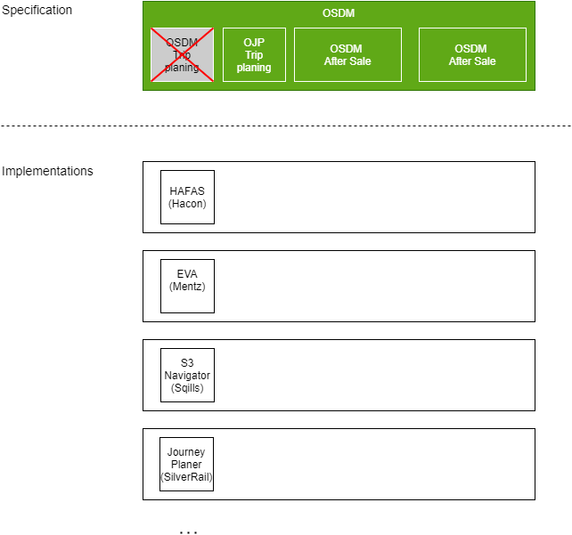
Location and Trip Search
The current OSDM has its own location and trip search specification.
To not add yet another specification, we OSDM would like to use OJP and include that to OSDM.
As OSDM is a REST/JSON specification, we need OJP in REST.

Slide 6
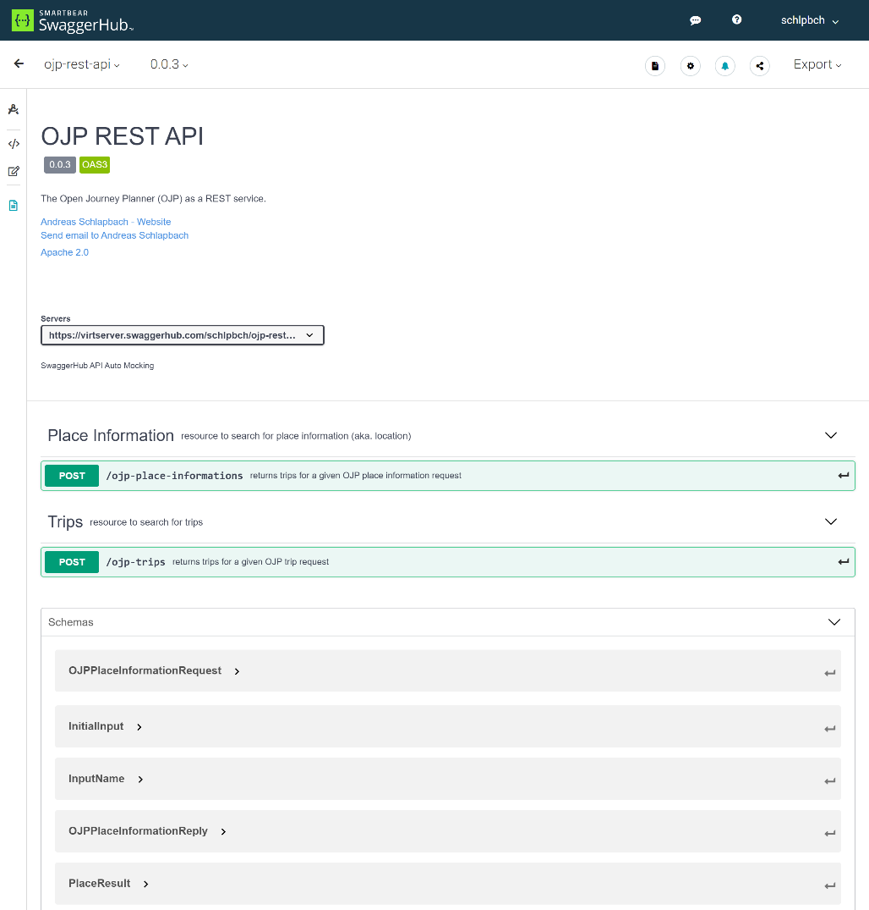
Initial Implementation
As a proof of concept, I’ve translated the OJP-Place-Informations and OJP-trips to OpenAPI.
https://github.com/schlpbch/ojp-rest-api
Topics identified are listed here:
Analysis of Mapping OJP-XML to OJP-JSON

Slide 7
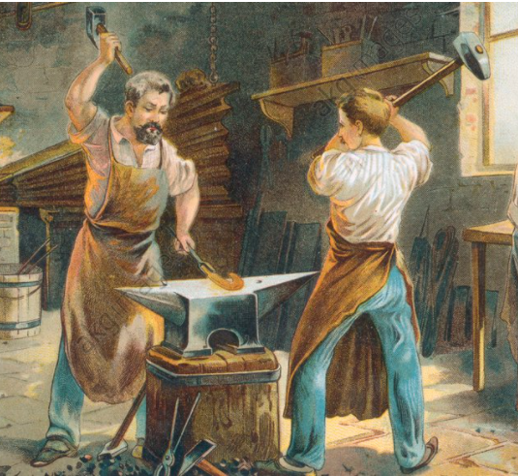
Possible Next Steps
Next step is to finalize the two resources with your support.
Jointly work on the reservation and booking
Align fares.

